Slide 1
Ethics Presentation
Chapter 4.2.3 to 4.4.2
Presented by David Garcia

Slide 2
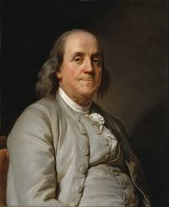
Benefits of Intellectual Property
“As we enjoy great advantages from the invention of others, we should be glad of an opportunity to serve others by any invention of ours; and this we should do freely and generously” - Benjamin Franklin
Notes:
Benjamin Franklin invented many useful items, including an improved wood stove, the lightning rod, the odometer, and bifocals and did not patent them.

Slide 3
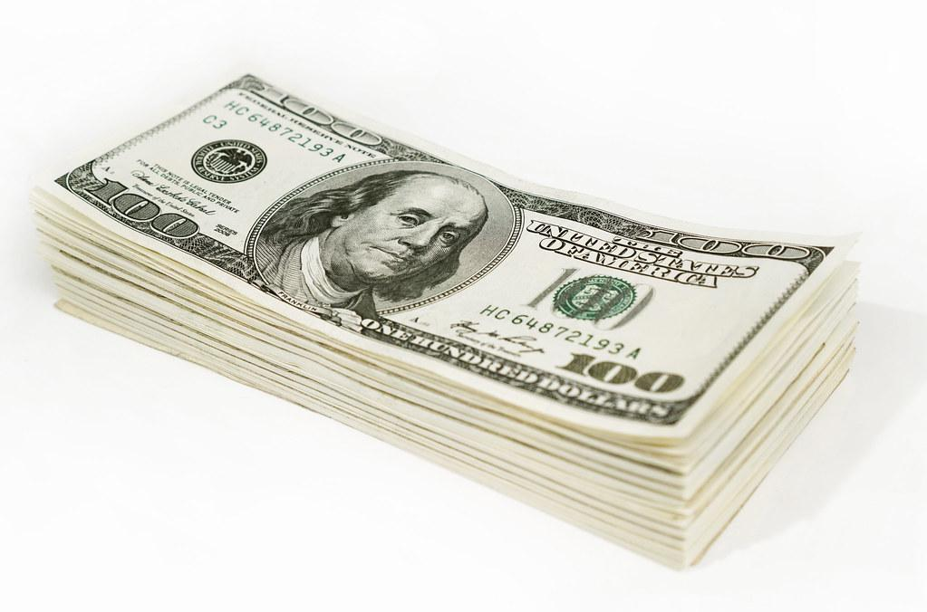
It’s all about the Benjamins
Article I, Section 8, of the US Constitution gives Congress the power to “promote the Progress of Science and useful Arts by securing for limited Times to Authors and Inventors the exclusive Right to their respective Writings and Discoveries.”
Notes:
Most people find the allure of money to be a strong motivator for putting in long hours with the hope of creating something useful. So if you create something and have the right to control the distribution and use you might be able to make a lil bit of money.
Mousetrap example: Make it yourself….choose to license your design to manufacturers who will pay you for the right to build with your design.
Or a company might be pay you for your design….choose to NOT use your design and the public does not benefit from your better technology.

Slide 4
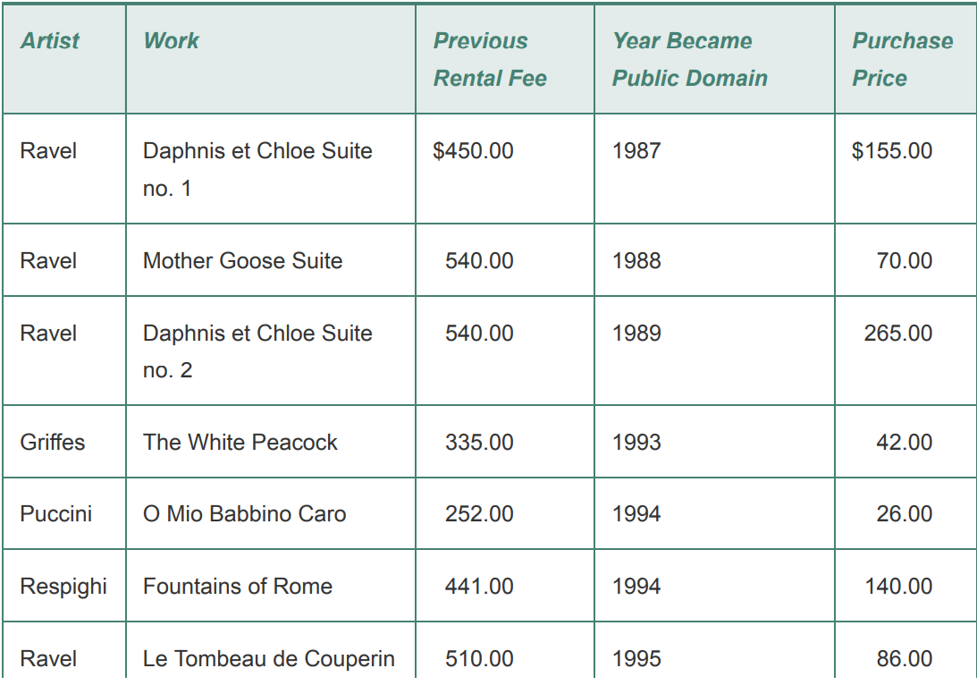
Limits to Intellectual Property
Copyright protection grants authors and inventors exclusive rights to their writings and discoveries but only for a limited period of time.
Notes:
While stuff is under copyright protection….you can still pay to use it….but it’ll be more expensive than if you wait until it enters public domain.
“Happy Birthday to You” published by Clayton F. Summy Company (subsidiary of Warner Music Group) copyrighted in 1935. Collects about $2 million a year in royalties for public performances.
Will be copyrighted until at least 2030 under the Copyright Term Extension Act of 1998

Slide 5
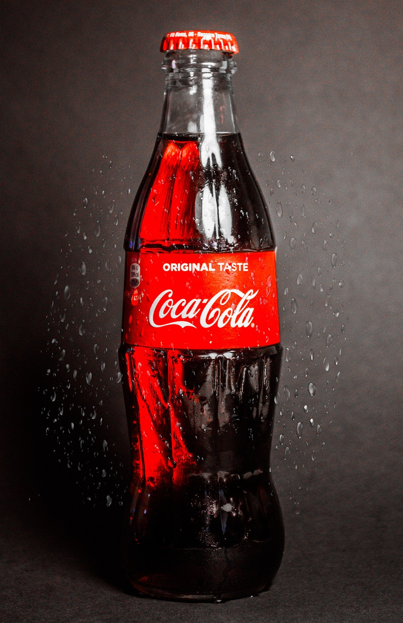
Protecting Intellectual Property
Trade Secrets: a confidential piece of intellectual property that provides a company with a competitive advantage.
Reverse Engineering: one way in which a competing firm can legally gain access to information contained in a trade secret.
Notes:
The formula to make the coca-cola syrup known as “Merchandise 7X” is locked in a bank vault in Atlanta, Georgia. Only a handful of people in the company know the entire formula and have signed nondisclosure agreements. Making the syrup is broken up into groups of employee.
Advantage….trade secret protection does not expire

Slide 6
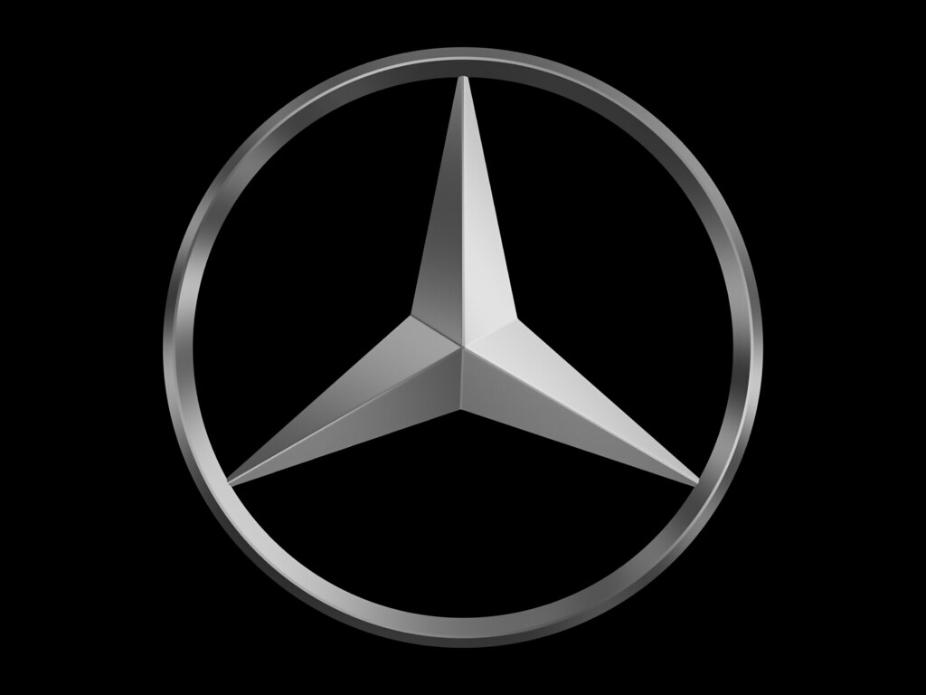
Protecting Intellectual Property
Trademark: a symbol, picture, sound, or color use by a business to identify goods
Notes:
When a company is the first to market a distinctive product, it runs the risk that its brand name will become a common noun used to describe any similar product. When this happens, the company may lose its right to exclusive use of the brand name. Some trademarks that have become common nouns are yo yo, aspirin, escalator, thermos, and brassiere.
Photoshop-“The Photoshop trademark must never be used as a common verb or as a noun. The Photoshop trademark should always be capitalized and should never be used in possessive form, or as a slang term”

Slide 7
Protecting Intellectual Property
Copyright: how the US government provides authors with certain rights to original works that they have written.
The right to reproduce the copyrighted work
The right to distribute copies of the works to the public
The right to display copies of the work in public
The right to perform the works in public
The right to produce new works derived from the copyrighted work
Notes:
Owner of a musical may sell a license to a high school drama club that wishes to perform it
Radio stations pay songwriters and composers to play their songs over the air through performance rights orgs such as ASCAP, BMI, or SESAC

Slide 8

Copyright Court Cases
Davey Jones Locker: Pay $99 for access to over 200 commercial programs.
No Electronic Theft Act of 1997: Made it a criminal offense simply to reproduce or distribute more than a thousand dollars’ worth of copyrighted material in a 6 month period
Notes:
DJ’s Locker: Richard Kenadek ran a bulletin board system. Was indicted in 1994 for copyrights infringement, plead guilty and sentenced to 6 mos house arrest.
Also in 1994 David LaMacchia, MIT student, posted copyrighted software on a public bulletin board he created on a university computer. Since he didn’t profit from his actions the lawsuit was dropped as he had found a loophole in the copyright law. To close the loophole Congress passed the No Electronic Theft Act

Slide 9
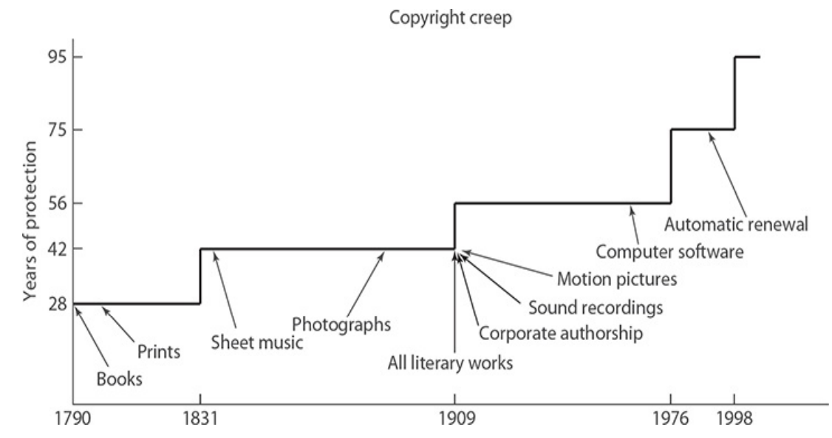
Copyright Creep
Notes:
Since the first Copyright Act was passed in 1790, both the length of copyright protection and the kinds of intellectual property that can be copyrighted have grown dramatically. Works created and published before Jan 1, 1978 are protected for 95 years and after are protected for the author’s lifetime plus 70 years after the author’s death.
If the work is made to hire then the protection is 95 years from release date or 120 years from the date of creation, whichever is less.

Slide 10
Fair Use
Makes it legal to reproduce a copyrighted work without the permission of the copyright holder.
Notes:
Makes it legal to reproduce a copyrighted work without the permission of the copyright holder.

Slide 11
Fair Use
Section 107 of the Copyright Act:
1. What is the purpose and character of the use?
2. What is the nature of the work being copied?
3. How much of the copyrighted work is being used?
4. How will this use affect the market for the copyrighted work?
Notes:
The United States Copyright Act does not precisely list the kinds of copying that are fair use. Instead, what is considered to be fair use has been determined by the judicial system. The courts have relied on Section 107 of the Copyright Act, which lists four factors that need to be considered
When judging the character of the use, the most important consideration is the extent to which the author has transformed the original copyrighted work.
Use of nonfiction is more likely to be permissible than the use of fiction.
Brief excerpts are more likely to be permissible than entire chapters.
Use of out-of-print material is more likely to be permissible than use of a readily available work. A spontaneously chosen selection is better than an assigned reading in the course syllabus

Slide 12
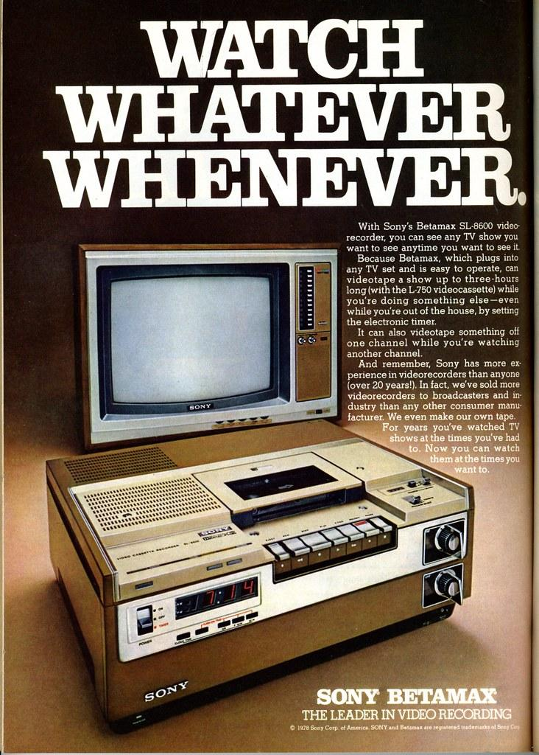
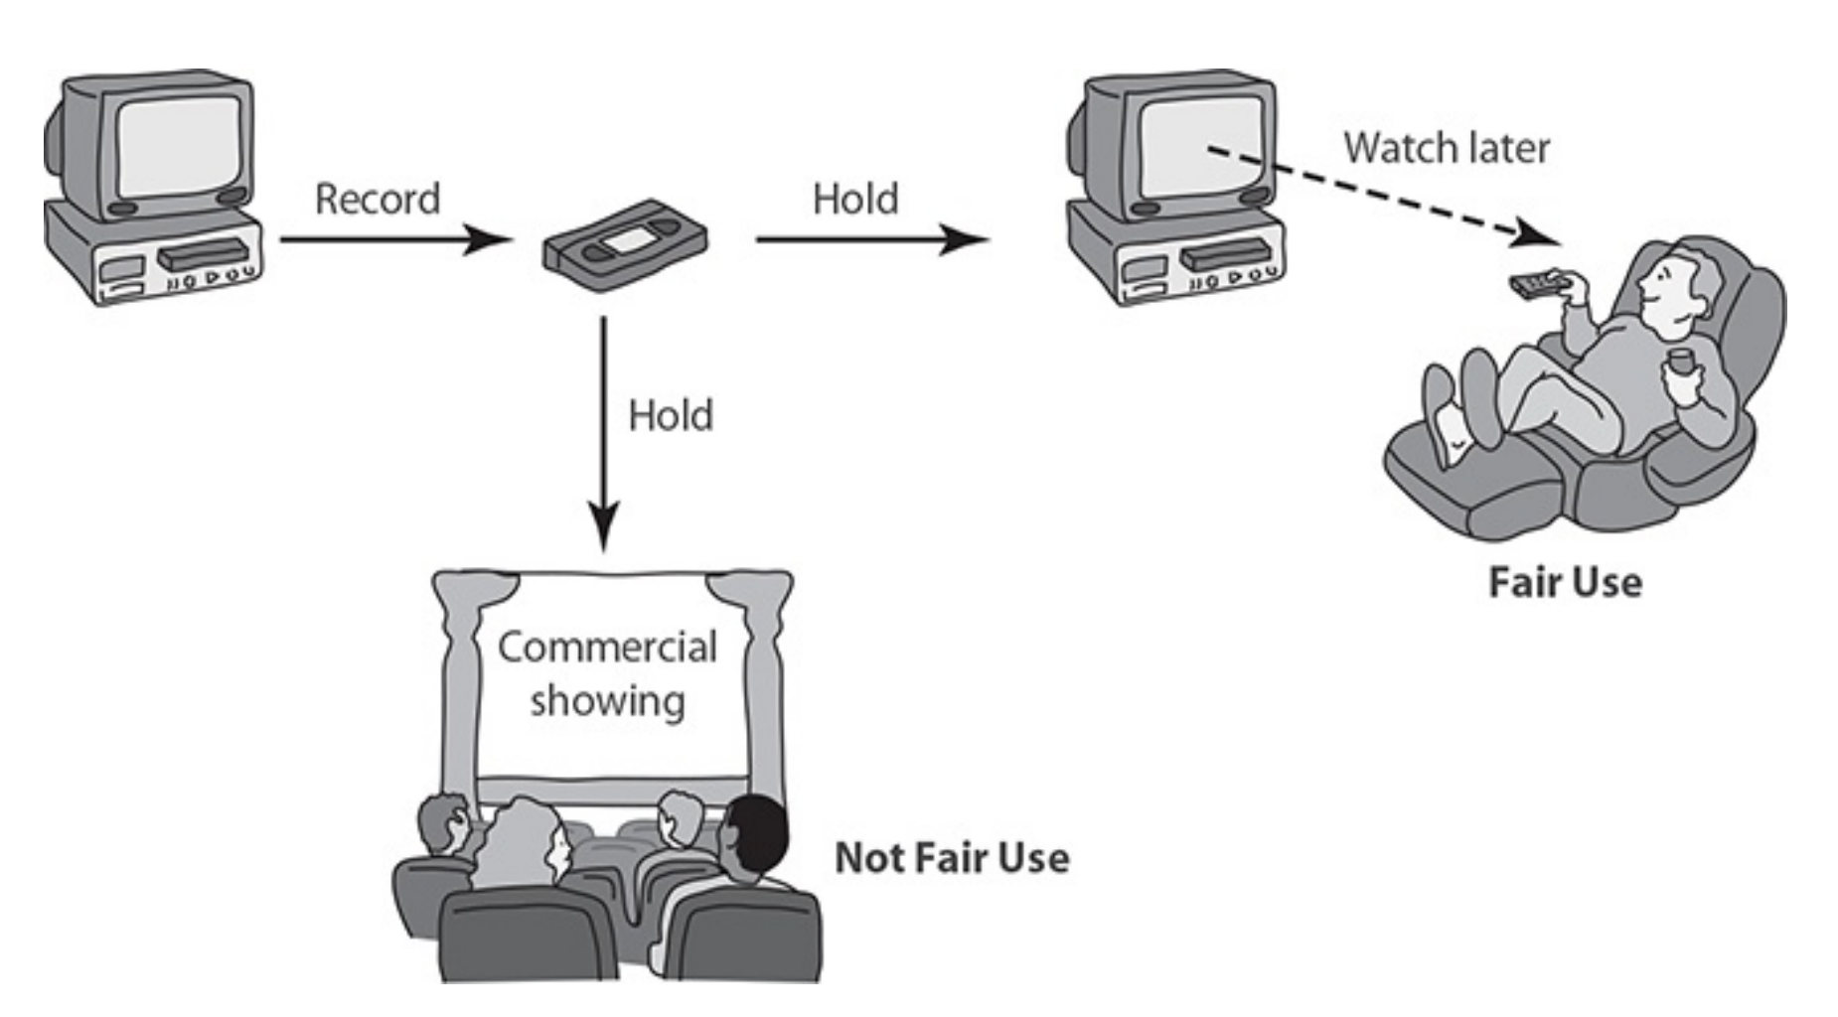
Sony v. Universal City Studios
Notes:
In 1975 Sony introduced its Betamax system, the first consumer VCR. People used these systems to record television shows for viewing later, a practice called time shifting. Some customers recorded entire movies onto videotape.

Slide 13
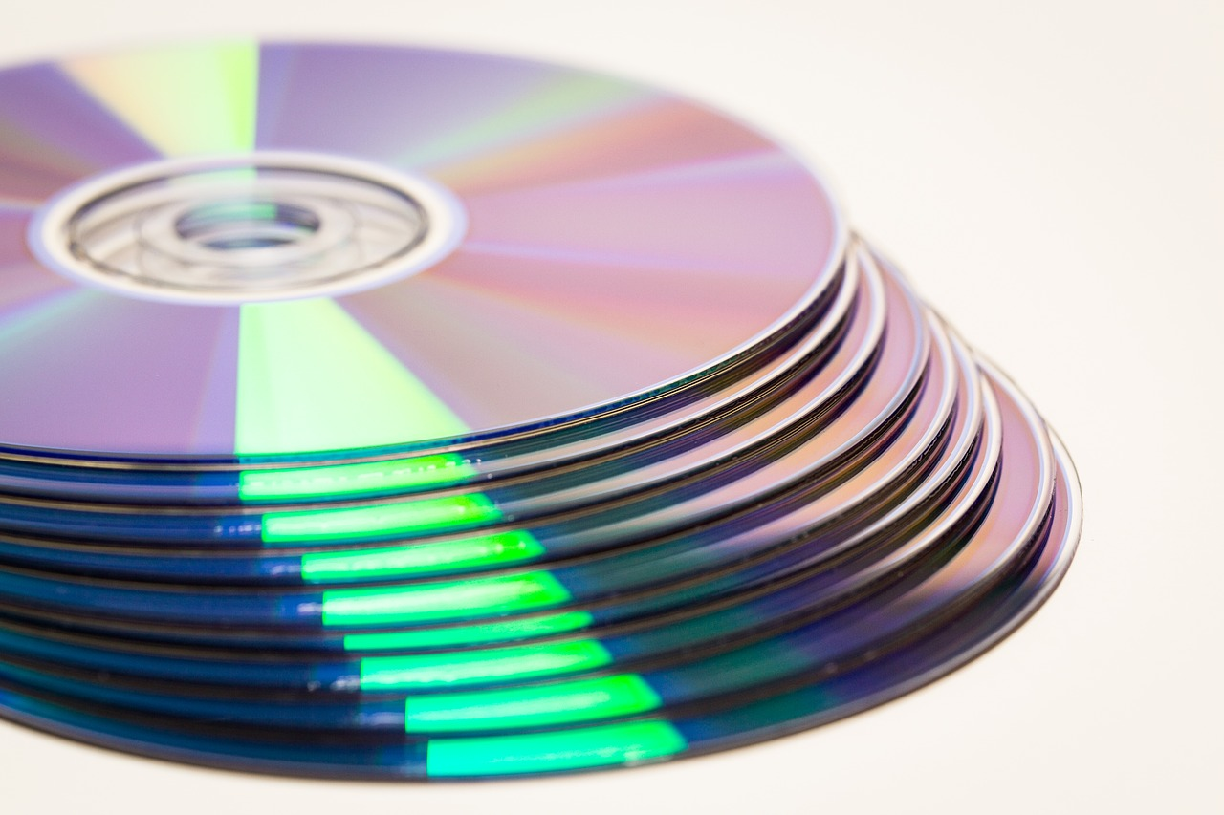
Audio Home Recording Act of 1992
Notes:
To reduce the problem of unauthorized copying, the Audio Home Recording Act requires manufacturers of digital audio recorders to incorporate the Serial Copyright Management System (SCMS). The SCMS allows a consumer to make a digital copy from the original recording, but it prevents someone from making a copy of the copy.
To compensate artists and recording companies for the loss of sales due to copying, the Audio Home Recording Act requires a royalty to be paid on the sale of all digital audio recording devices and blank digital audio recording media. The royalties are divided among songwriters, music publishers, musicians, and recording companies, based on the popularity of their music

Slide 14
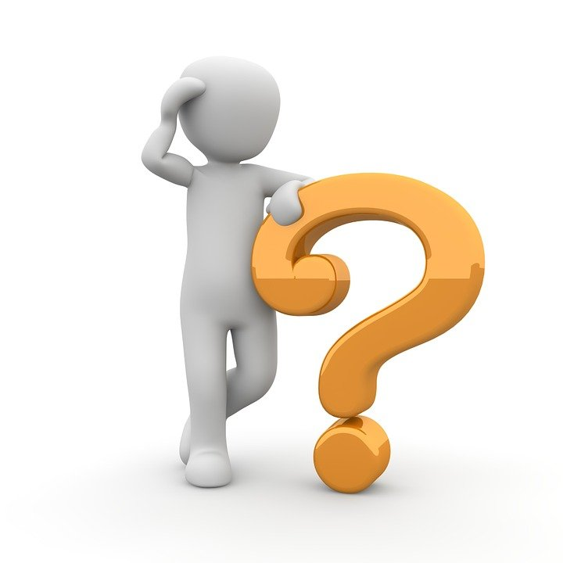
The End

